Slide 1

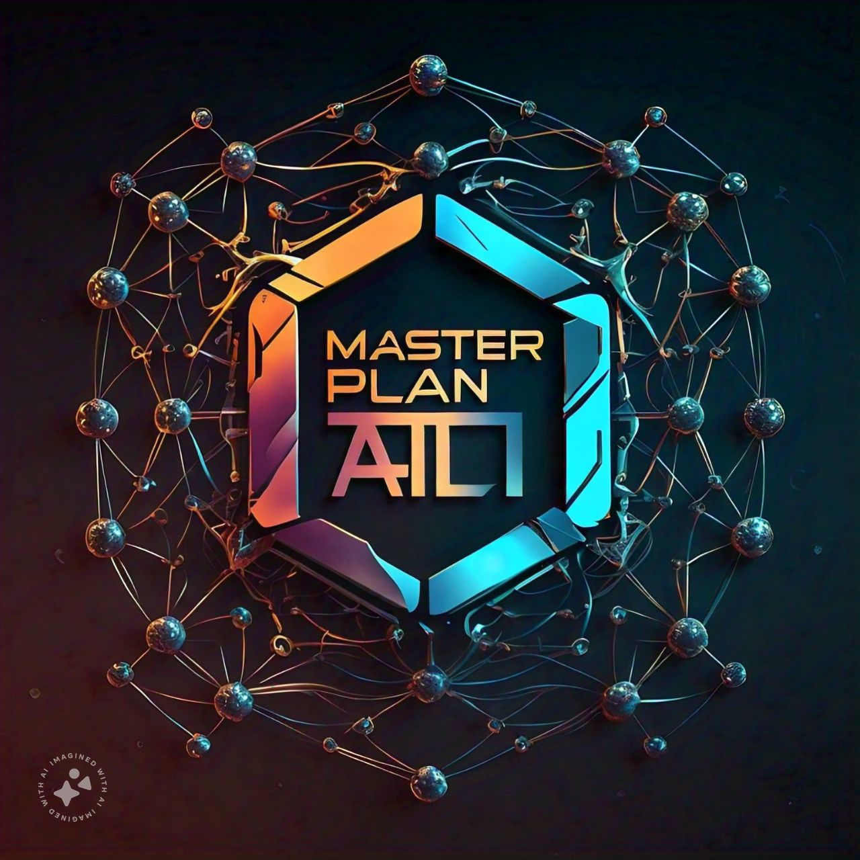

Ton Society Hackathon Submission
The Masters of the Universe team is participating in the Hackers League Hackathon at the Gurugram Bootcamp. They are presenting their innovative project, Master Plan AI.
by Martin Luther

Slide 2




Team Members
Martin Luther
Software Developer
Skilled in web3 development and product management.
Diverse Roles
Team comprises developers and product managers from various companies/colleges.
Professional Profiles
Each member has a LinkedIn profile showcasing their expertise.

Slide 3

Project Title: Master Plan AI
Innovative Solution
User-Friendly
Centralized Hub
Master Plan AI is a comprehensive directory for AI tools.
Designed for both developers and non-technical users.
Provides easy access to a wide array of AI solutions.

Slide 4
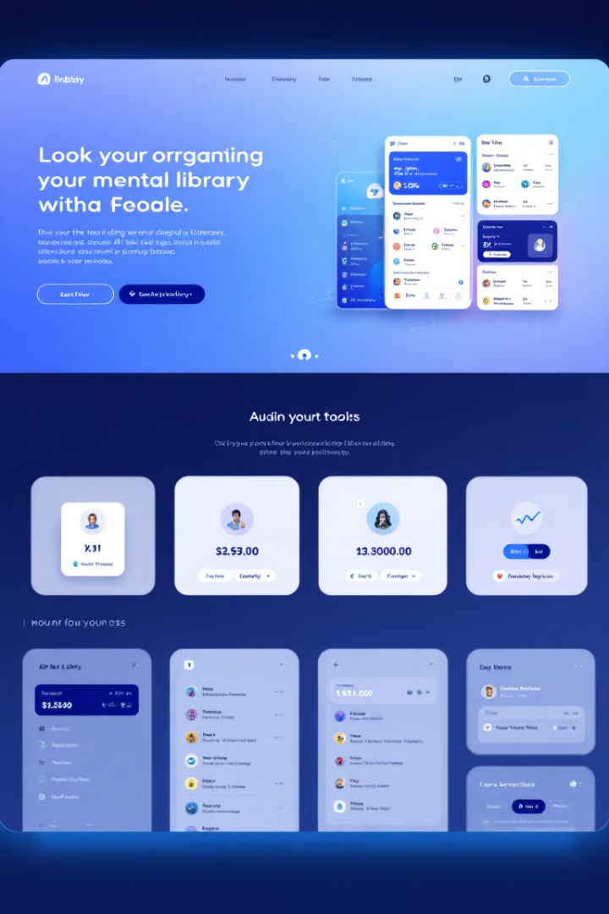
Project Summary
1
Comprehensive Directory
Centralized hub for discovering AI tools across various domains.
2
User-Friendly Interface
Designed for both technical and non-technical users.
3
Workflow Optimization
Features intuitive AI automation tools to streamline tasks.

Slide 5
Hackathon Track
Deft
Social Web3 & Utility
On-Chain Data Analysis
Focusing on efficient solutions.
Integrating blockchain technology.
Leveraging blockchain data insights.

Slide 6

Problem Statement
1
Choice Overload
Users struggle to identify suitable AI solutions due to tool proliferation.
2
Productivity Loss
85% of developers spend over two hours weekly searching for tools.
3
Market Growth
Global AI market projected to grow at 37.3% annually.

Slide 7




Personal Motivation
Challenges Faced
Difficulty in identifying right tools to enhance productivity.
Time Wasted
Steep learning curves lead to inefficient use of resources.
Solution Proposed
Master Plan AI aims to alleviate these challenges.

Slide 8

Project Goals
1
Mitigate Choice Overload
Curate AI tools into a comprehensive, user-friendly directory.
2
Bridge Knowledge Gap
Connect developers and non-technical users with appropriate AI resources.
3
Enhance Productivity
Save time and resources during the tool discovery process.

Slide 9
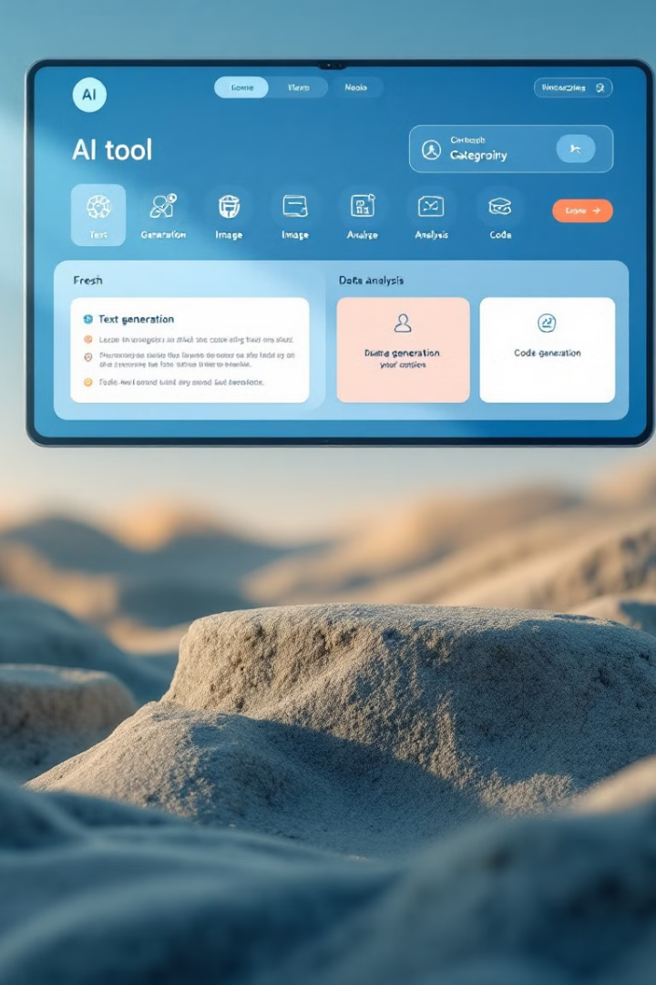
Project Structure and Key Features
1
Categorized Directory
AI tools organized by purpose (productivity, automation, data analysis, marketing).
2
In-depth Tool Profiles
Detailed information on functionality, pricing, learning curve, and user feedback.
3
Recommendation Engine
Personalized suggestions based on user preferences and challenges.

Slide 10
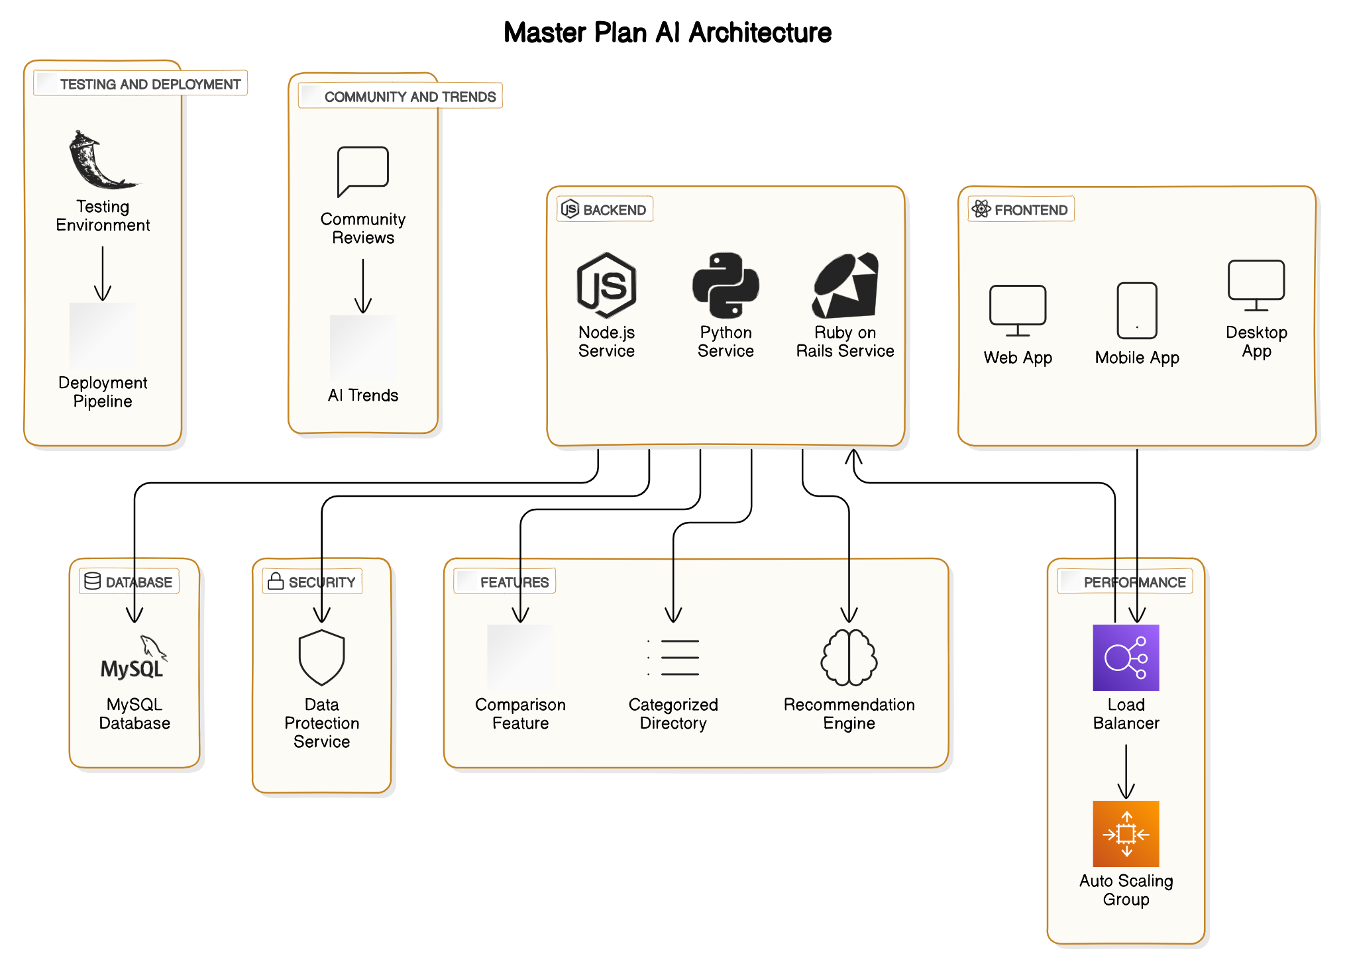

Slide 11

Competitors of the Master Plan AI Tool
1. AI Hub Focuses on providing various AI tools with an emphasis on deep learning and neural networks. Offers detailed tutorials and community support.
2. ToolBox AI Aims to streamline productivity with a wide range of AI tools, including advanced automation features and seamless integration with other software.
3. AI Toolkit Specializes in offering user-friendly AI solutions, particularly for small businesses and startups looking to leverage AI without a steep learning curve.
4. AI Directory Pro Provides a curated list of AI tools with in-depth reviews, user ratings, and comparison features to help users make informed decisions.

Slide 12
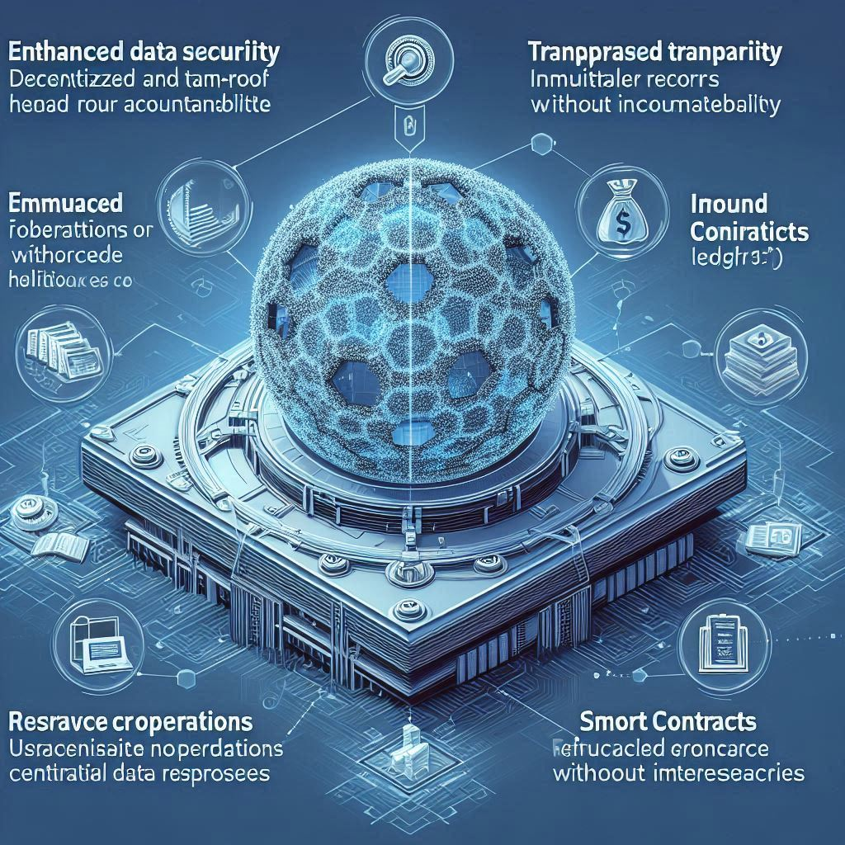
-------------------------------------------------
| Enhanced Data Security | Transparency |
| [Graphic] | [Graphic] |
| "Decentralized and | "Immutable |
| tamper-proof ledger" | records for |
| | accountability" |
-------------------------------------------------
| Improved Trust and | Decentralized |
| Credibility | Data Management |
| [Graphic] | [Graphic] |
| "Verifiable operations | "Reduced |
| without intermediaries" | reliance on |
| | centralized |
| | data repositories"|
-------------------------------------------------
| Smart Contracts for | Data Integrity |
| Automation | and Quality |
| [Graphic] | [Graphic] |
| "Automate data sharing | "Ensures |
| agreements" | accuracy and |
| | reliability" |
-------------------------------------------------

Slide 13

Facilitating Collaboration
Blockchain can enable secure and efficient collaboration among various stakeholders, allowing them to share data and resources while maintaining control over their contributions.
Regulatory Compliance
The transparent nature of blockchain can help the project comply with data protection regulations by providing an auditable trail of data access and usage.
Lowering Barriers to Entry
By democratizing access to high-quality data through blockchain, smaller organizations can participate in AI development, fostering innovation and diversity in the AI ecosystem.
Potential for New Business Models
The combination of AI and blockchain can lead to the creation of new business models, such as data marketplaces, where users can monetize their data while maintaining privacy and control.
These points highlight the critical role that blockchain technology can play in enhancing the Master Plan AI project, ensuring it is secure, transparent, and efficient.

Slide 14
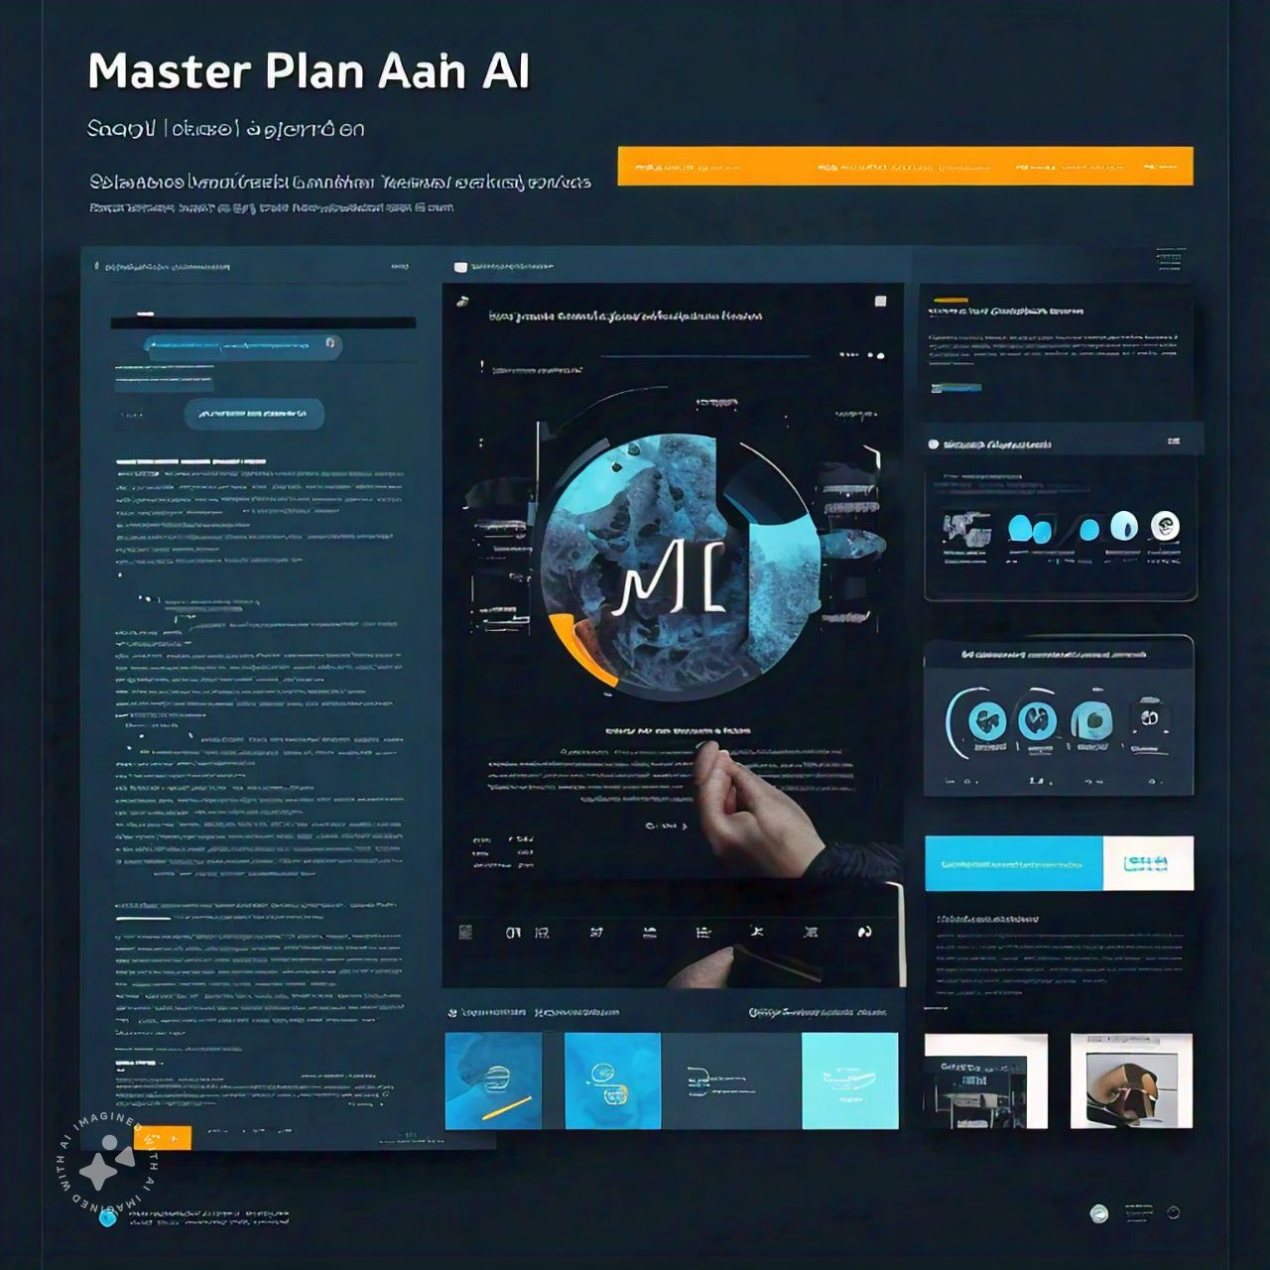

Slide 15

Conclusion
Revolutionary Platform
Master Plan AI simplifies AI tool discovery and utilization.
Comprehensive Directory
Provides intuitive access to effective AI solutions.
User-Centric Approach
Caters to both developers and non-technical users.

